Slide 1

Coordination model and digital twins for managing energy consumption and production in a smart grid.
Philippe Glass
Start date: September 2022
Supervisor: Giovanna Di Marzo Serugendo
Target delivery date: June 2025
LASAGNE project (ERA-NET)
Notes:
• Résumé de la problématique
Motivation, problématique, questions de recherche
• Plan d’avancement de la thèse
Description de la planification de la recherche. On signalera les éventuels retards par rapport au plan produit lors de la dernière évaluation périodique (à savoir celle de décembre 2023).
• État d’avancement
Description du travail effectué depuis la dernière évaluation périodique. On y pointera les éventuelles difficultés et les réorientations de la thèse.
• Écoles doctorales suivies
Vous indiquerez sous ce point, s’il y a lieu, toutes les formations en lien avec votre doctorat que vous avez suivies depuis la dernière évaluation périodique.
• Participation à des colloques, congrès scientifiques
Vous indiquerez sous ce point, s’il y a lieu, tous les colloques, congrès scientifiques, etc. auxquels vous avez participé de manière active (communication ou organisation). Les colloques, congrès scientifiques, etc. auxquels vous avez assisté doivent être répertoriés au rang des écoles doctorales suivies depuis la dernière évaluation périodique.
• Publications en lien avec la thèse
Vous indiquerez sous ce point, s’il y a lieu, toutes les publications en lien avec votre doctorat que vous avez signées ou co-signées depuis la dernière évaluation périodique.

Slide 2
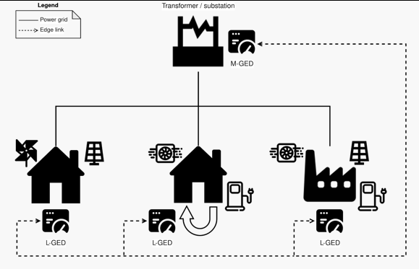
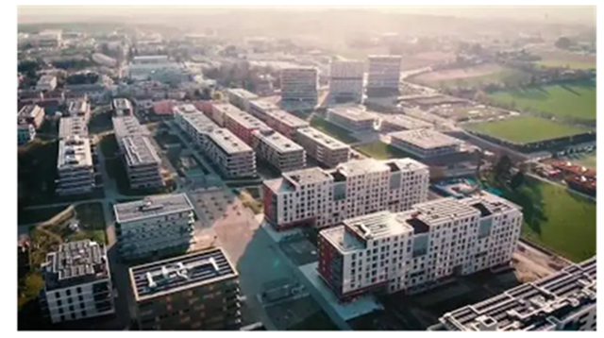

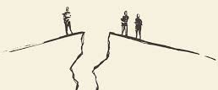
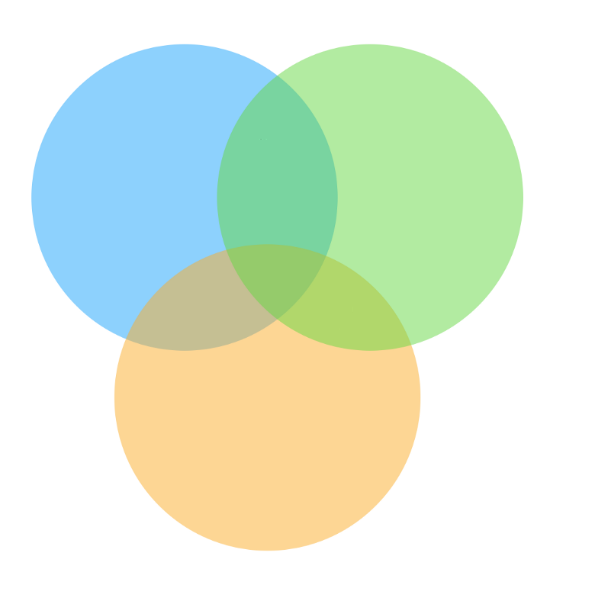
Setting the stage
Context
LASAGNE project (Switzerland/Sweden)
To integrate “intelligence” and autonomy in smart-grid edge devices
Research Gaps
Microgrid node computing units are not able to exchange energy in an autonomous and decentralised way.
Difficulty to manage renewable energies whose production is particularly fluctuating in time
Social dimension not considered in smart-grids (equity, environmental protection, fairness, user's profiles and preferences)
State of the art
Coordination models
Multi-agent
systems
Holonic architecture at different levels:
[David Menga, ... “A Generic Holonic Control Architecture for Heterogeneous Multi-Scale Smart Micro-Grids..(2014) ]”
Sapere model:
(inspired by biology & chemistry)
[Castelli, Gabriella et al. “Engineering pervasive service ecosystems: the Sapere approach” (2015)]
Machine learning
Contribution: Coordination model and DT for managing energy consumption and production in a smart grid.
Distributed Federated Learning:
[Wei Liu, Li Chen, and Wenyi Zhang: “Decentralized Federated Learning: Balancing
Communication and Computing Costs” 2022]

Slide 3
Solutions / Scientific contributions
A PhD thesis in Information Systems constitutes at least three different scientific contributions
More computer science contributions
A new area
Unifying framework
Resolving long-standing question
Thoroughly exploring an area
Contradicting existing knowledge
Experimentally validating theory
Producing an ambitious system
Providing an empirical data
Deriving superior algorithms
Developing new methodology
Developing a new tool
Producing a negative result
…
More human-centric computing contributions
Ethnographic studies
Critical design
Design guidelines
Design artifacts
Methodological innovations
Toolkits and platforms
Human factors research
…
Human factors research (social acceptance algorithms)
Deriving superior algorithms (DT + gossip FDL)
Developing a new model (coordination model)
Based on https://www.eecs.harvard.edu/htk/phdadvice/ Jacob O. Wobbrock and Julie A. Kientz. 2016. Research contributions in human-computer interaction. interactions 23, 3, 38–44. https://doi.org/10.1145/2907069

Slide 4

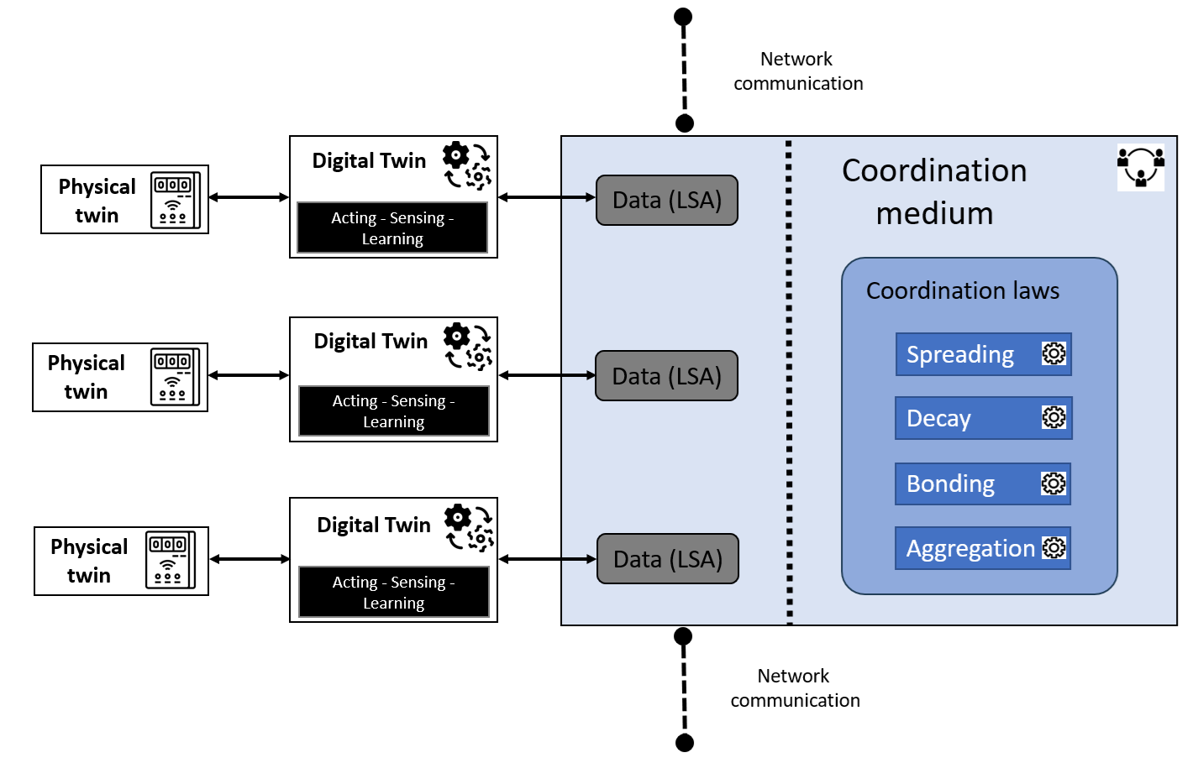
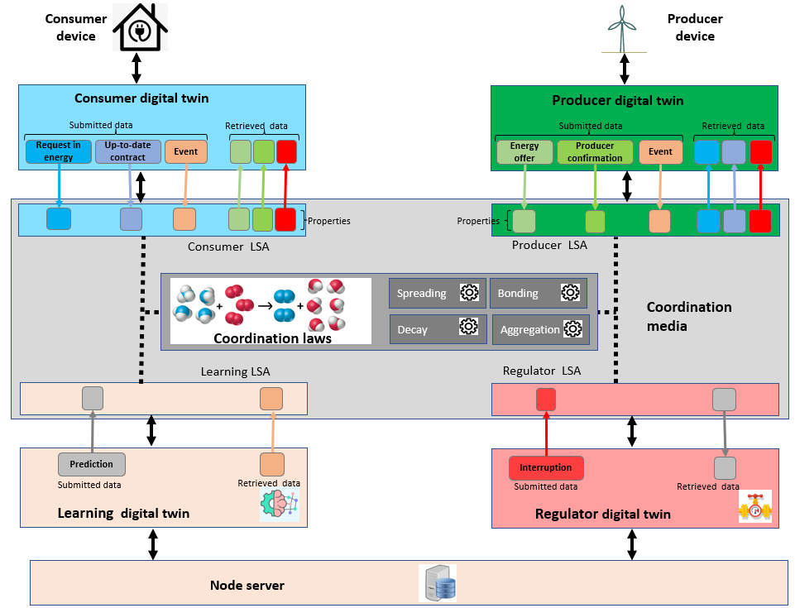
1: Design of a Coordination Model and Digital Twins for exchanging energy in smart grids
Research questions
Can we design a coordination model and mechanisms that allows Grid Edge Devices to collectively achieve energy locally?
How can we model the notion of digital twins to represent micro-grid entities which exchange and regulate energy at a local level?
Method
Implementation of a coordination model using:
shared virtual environment (tuple space)
coordination laws.
Designing and implementing Digital Twins which interact though the virtual environment.

Slide 5
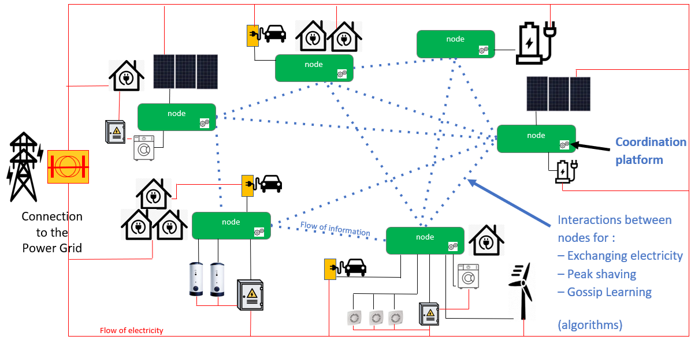
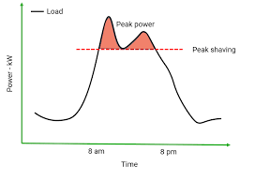
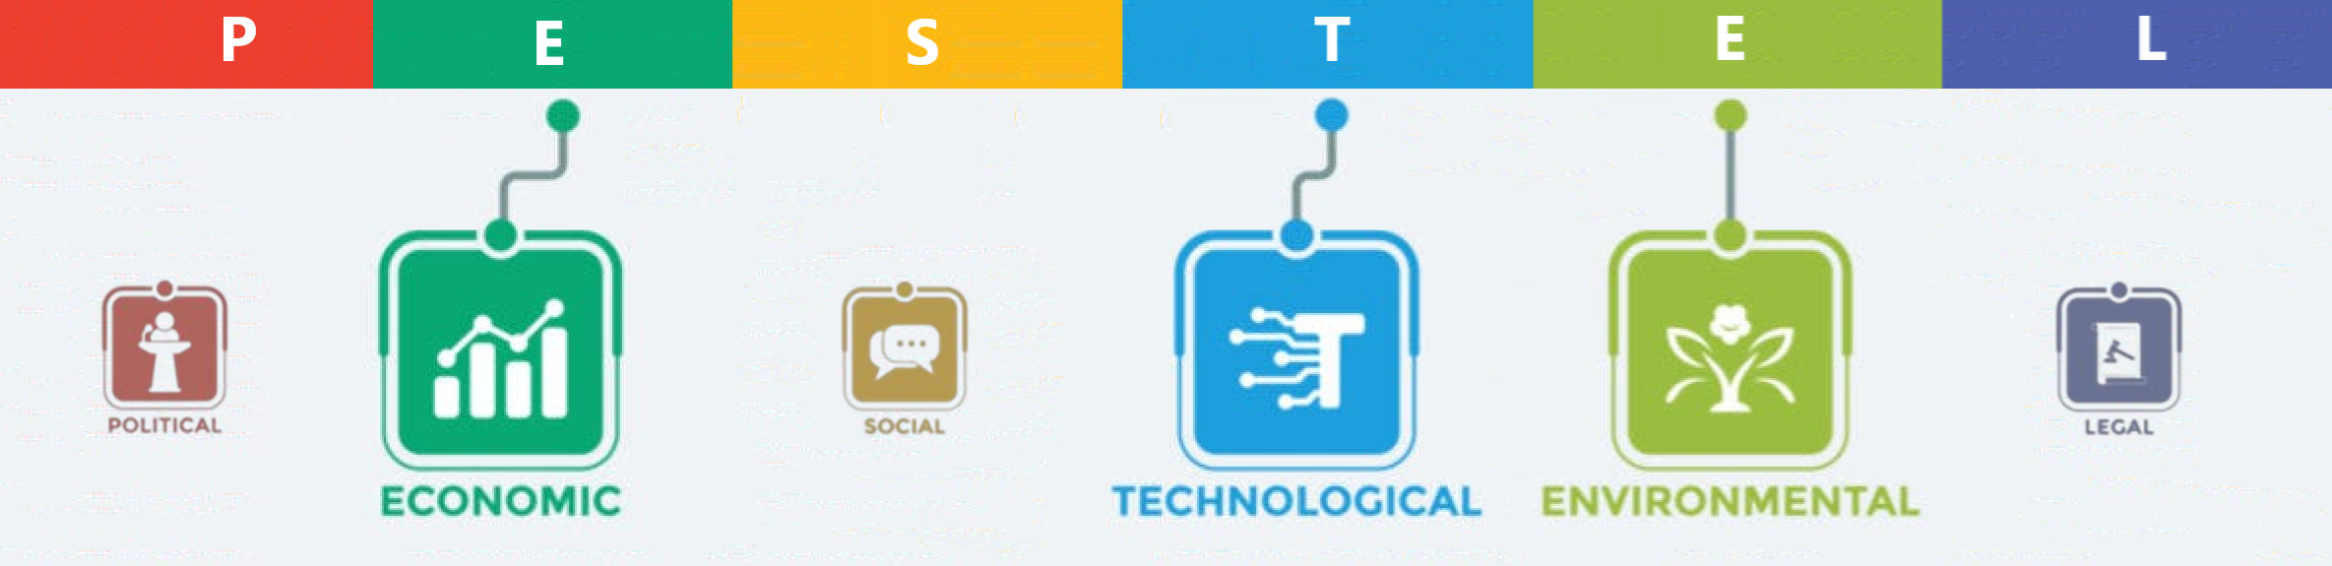
(1: Design of a Coordination Model and Digital Twins for exchanging energy in smart grids )
Results
Interactions to exchange electricity
Interactions to manage peak shaving
Contributions & Implications
Save money and energy (by facilitating local transactions)
Avoid peaks.
Integrate renewable energies.
Example of epic fail(s)
Generating a supply contract takes time when there are many requests at the same time.
No time to integrate prosumer price negotiation (peer-to-peer or multilateral negotiation).

Slide 6
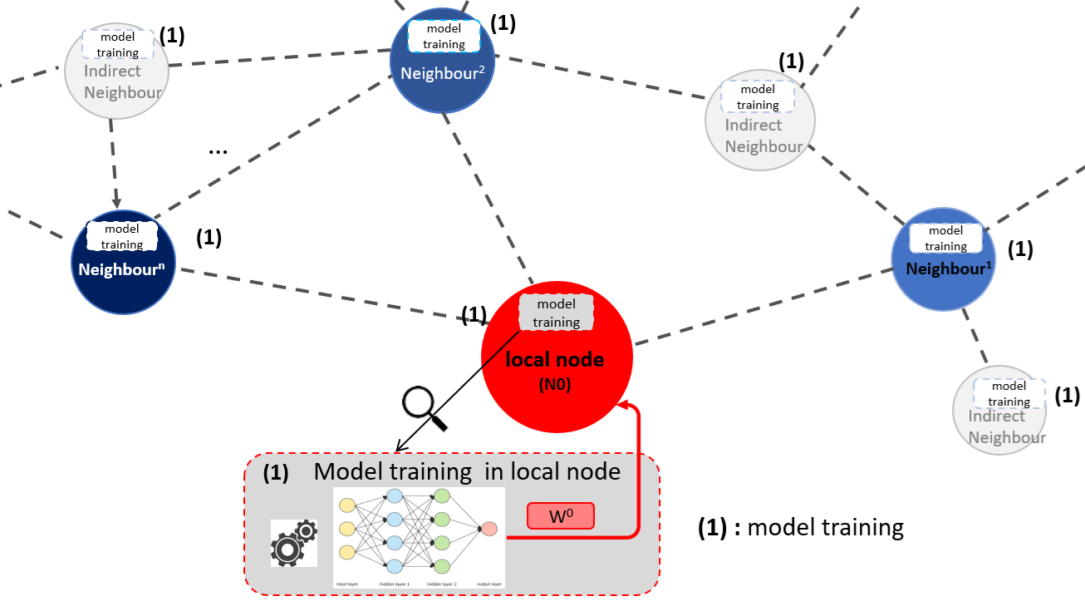
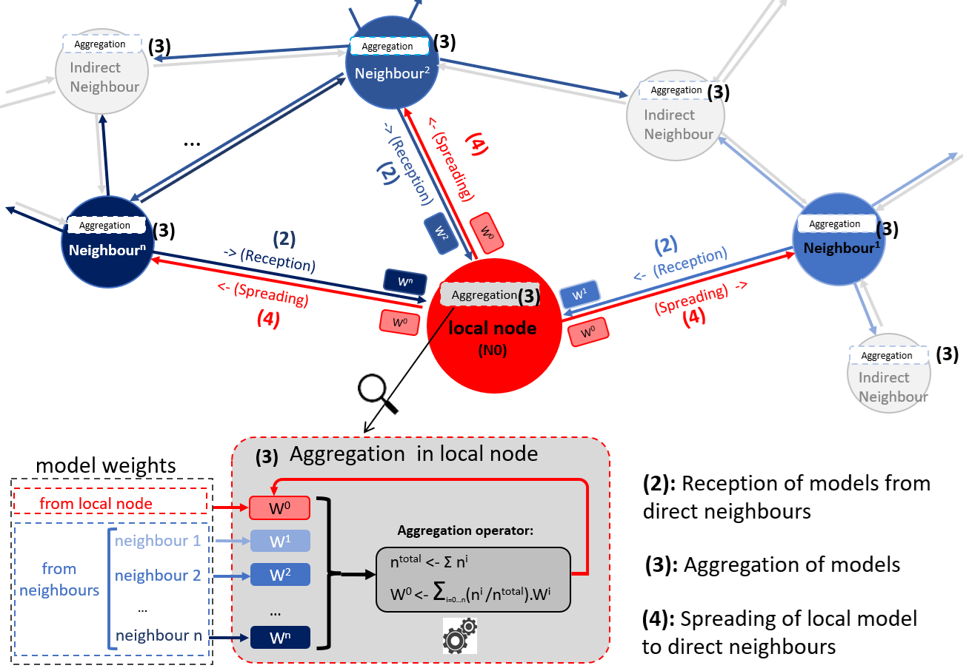
2: Gossip coordination mechanism for distributed Learning
Research questions
How can we integrate into the coordination model a mechanism of Gossip based Federated learning, with an aggregator that the client layer can define on the fly?
Method
Introduce the “gossip” mechanism into the coordination model with a generic aggregator
Apply the “gossip” mechanism to distribute and combine a generic structure of learning models.
(Training models)
(Sharing models)
• Experimentation with 2 different learning models: Markov Chains and LSTM.

Slide 7
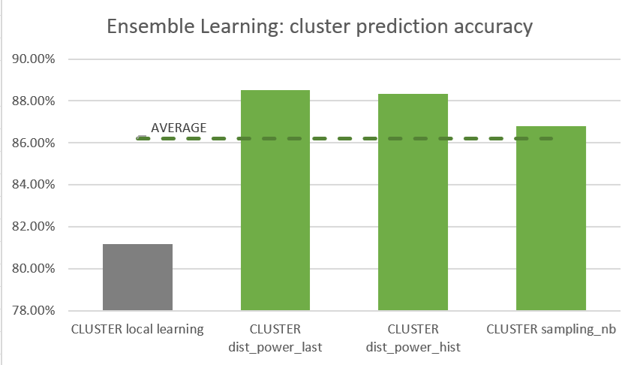
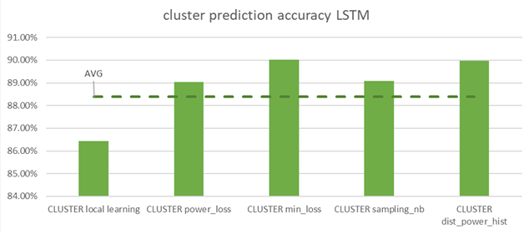
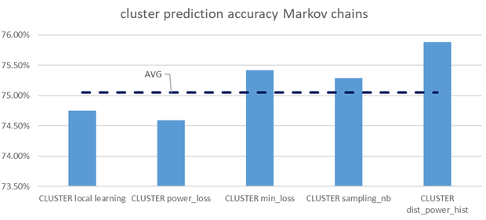
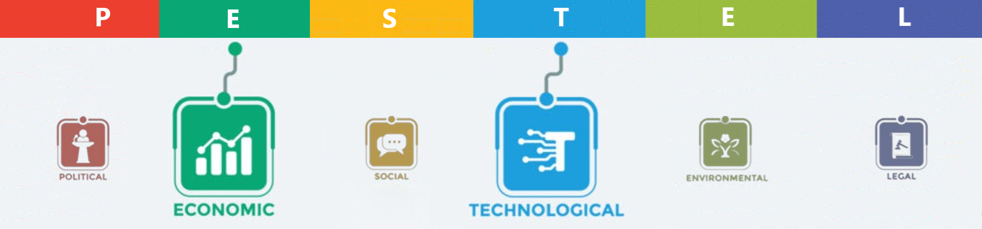
(2: Gossip coordination mechanism for distributed Learning)
Results
Gossip DFL: Comparison of 5 aggregators:
sampling number, power loss, min loss, power profile, no aggregation
Gossip EL: Comparison of 3 aggregators power profile , last power, no aggregation
‘min loss’ outperforms
‘Power profile’ outperforms
‘Last power’ outperforms
Contributions & Implications
Integration of a flexible model distribution mechanism which help:
to increase learning accuracy.
to reduce communication overhead.
to ensure data privacy.
Example of epic fail(s)
Difficulty in predicting the gains in accuracy provided by an aggregator (depends on the ML model, hyperparameters, perimeter, ....).
We have not considered the impact of the gossip frequency.

Slide 8
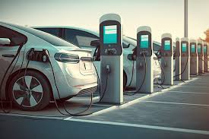


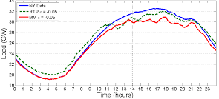
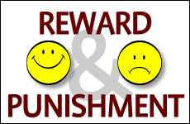
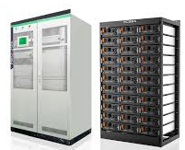
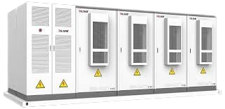
3: Integration of social acceptance by design
Research questions
To what extent can we integrate criteria of social acceptability into Digital Twins behaviours, in decision-making processes for electricity transaction and electricity regulation?
Method
Meetings with partners from the HES-SO Valais, who have produced a study on social acceptance by design.
Implementation of “prosumer” digital twin (represent a member in a community grid).
Implementation of scenarios that highlight social dimension problems:
Tragedy of the common
Free-rider behaviours
General shortage
Integration of new behaviours in Digital Twin algorithms to address the identified issues:
Dynamic pricing (to encourage deferral of electricity demand)
Reward management (to penalise ‘Free-rider’ behaviour)
Modelling of Private/Common energy storage
Assessments with the scenarios implemented

Slide 9
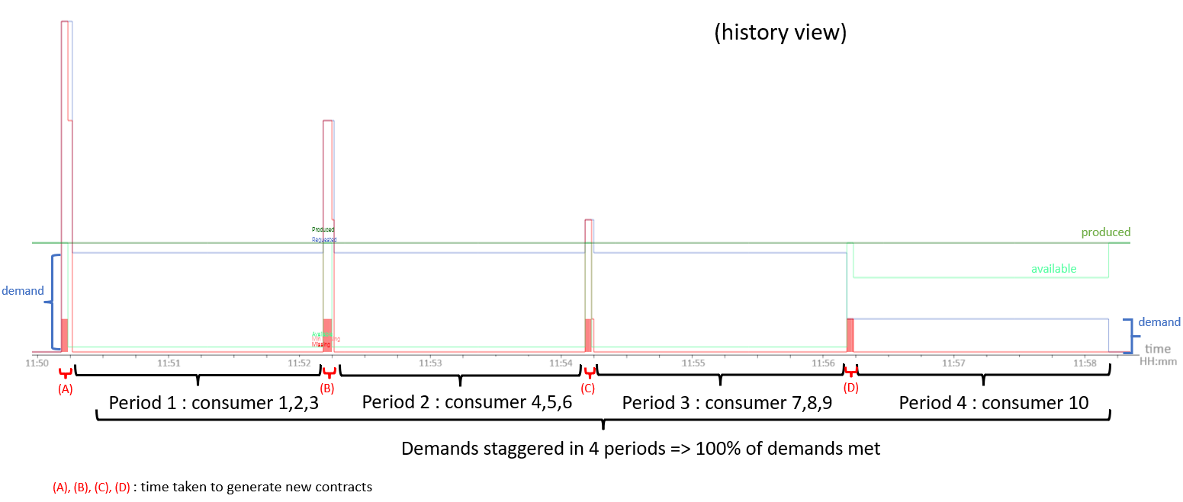
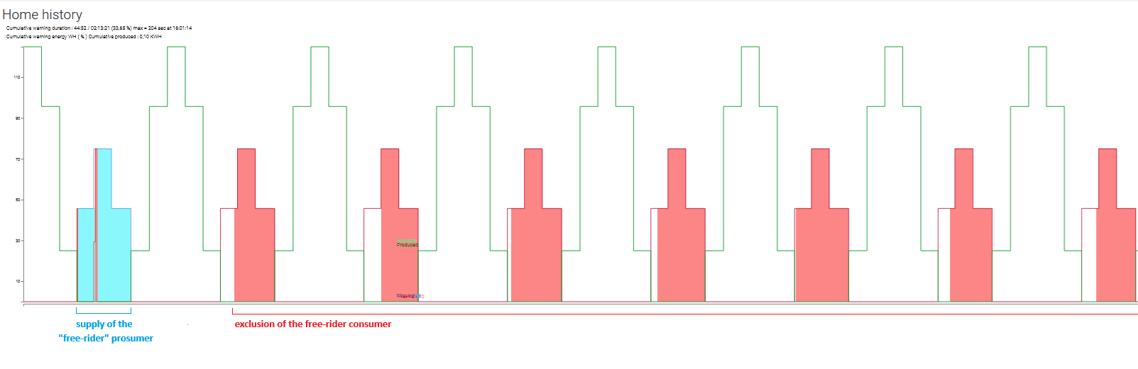
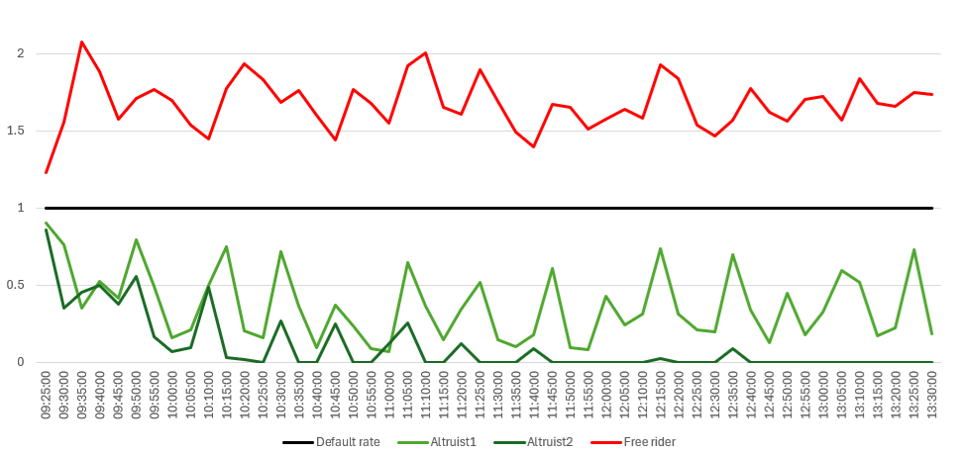
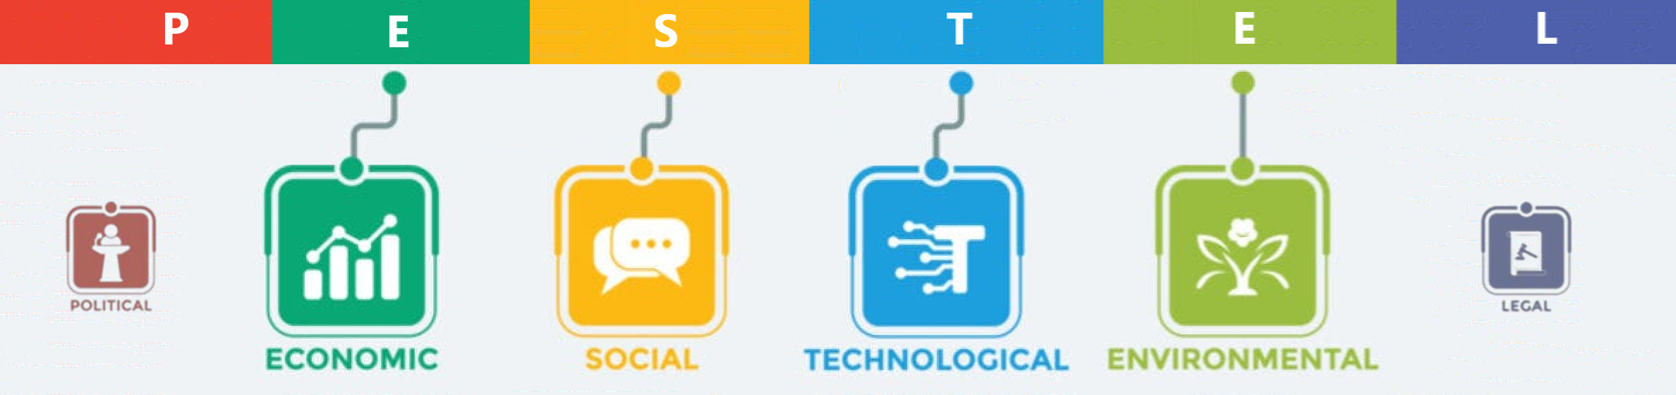
(3: Integration of social acceptance by design)
Results
Tragedy of the common: staggered demands
Penalties for free-rider prosumers
Exclusion in energy supply
increase of KWH price
Contributions & Implications
Facilitates the integration of new social dimension criteria
Proof that it is possible to reconcile social and technological aspects in a microgrid.
Improving the chances of success of a microgrid project
Example of epic fail(s)
We had to simplify certain criteria before integrating them into the coordination platform.

Slide 10


Scientific contributions & Peer-reviewed publications (past/planned)
 | Design of a coordination model and Digital Twins for exchanging energy in smart grids | Gossip coordination mechanisms for distributed Learning | Integration of social acceptance by design
Full paper reference (your name in bold) | Coordination Model and Digital Twins for Managing Energy Consumption and Production in a Smart Grid P Glass, G Di Marzo Serugendo https://www.mdpi.com/1996-1073/16/22/7629 | Gossip coordination mechanisms for Distributed Learning P Glass, G Di Marzo Serugendo (submission planned on MDPI) | Fragniere, Emmanuel and Sandoz, Sarah and Abdenadher, Nabil and Moussa, Mohamad and Di Marzo Serugendo, Giovanna and Glass, Philippe: Improving the Social Acceptability of Microgrids (IEEE Renewable Energy and Sustainable E-Mobility Conference (RESEM), May2023 https://ieeexplore.ieee.org/abstract/document/10236324
I.F./conference A.R. | IF=3.0 (paper) | IF=3.0 (paper) | AR=30% (conference)
Contribution to thesis | Developing of a new coordination, which derives from SAPERE. Implementation of the digital twins that represent the microgrid entities. | Integration of Gossip Federated Learning and Gossip Ensemble Learning using the coordination model. | Integration of social acceptance by design in the Digital Twins behaviours.
Scientific contribution type | Developing a new model , Deriving superior algorithms | Deriving superior algorithms | Human factors research, Deriving superior algorithms
Your/author Contributions* | P. Glass designed and implemented the algorithms, scenarios and needed databases. | P. Glass designed and implemented the algorithms, scenarios and needed databases. | P. Glass has participated in studies/surveys
Ethical approval for a human subject's study | Not applicable | Not applicable | Not applicable
If applicable: (any other comments)
Google Scholar profile: https://scholar.google.com/citations?hl=fr&user=oh_BXHgAAAAJ
ORCID profile: https://orcid.org/0000-0002-6258-0034

Slide 11

Beyond scientific impacts
Presentations:
Poster session at the Data-science day, September 15, 2022
PhD Thesis yearly presentations, Geneva, February 6-7, 2023
Poster session at the PhD student day, Geneva, September 29, 2023
PhD Thesis yearly presentations, Geneva, February 15-16, 2024
Face-to-face Lasagne meeting, Stockholm, September 27, 2022
Face-to-face Lasagne meeting, Sierre, June 8, 2023
Face-to-face Lasagne meeting, Stockholm, September 3-4, 2024
Session on Digital Twins and AI semantic, Geneva, November 7, 2024
Funding: ERA-NET (European Research Area)
https://www.eranet-smartenergysystems.eu/
Recognition:
Not applicable
Service:
Preparation of Project challenge for Energy data Hack days 2023, Brugg-Windisch.
Project peer reviews with ERANET sessions, June 2024.
Outreach and Community Engagement:
LASAGNE Dissemination event with DSO, R&D partners, industrial partners, General public:
April 2025: Val d’Anniviers
May 2025: KTH, Stockholm (Energy communities - the new energy landscape)
Beyond scientific impacts:

